Slide 1
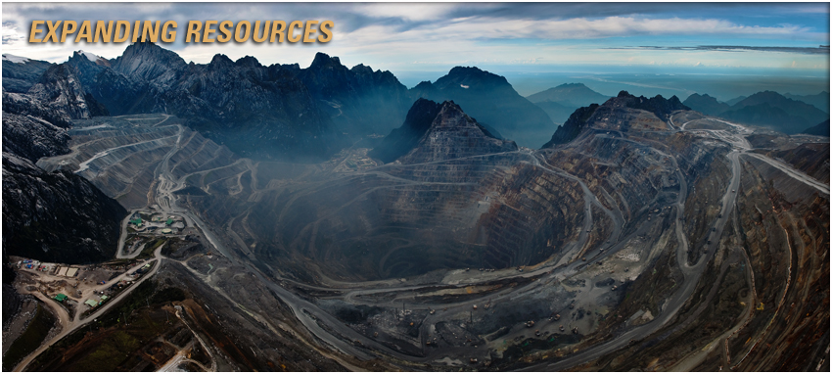
Freeport McMoRan Copper & Gold Inc.: Financial Analysis
First Last
FIN500 – Principles of Finance
Colorado State University – Global Campus
Dr. Felicia Olagbemi
March 16, 2014
http://www.fcx.com/index.htm

Slide 2
The History of FCX
Began in 1912 as Freeport Sulphur in Freeport, TX.
In 1960’s Freeport Indonesia formed and confirms Indonesian copper deposit.
In 1971 changes name to Freeport Minerals Company.
In 1981 combines with McMoRan Exploration and McMoRan Oil & Gas to form Freeport-McMoRan Inc. Main products included sulphur, phosphoric acid, gold, copper, silver & uranium.
In 2007 FCX acquires Phelps Dodge Corporation with copper and molybdenum holdings.
In 2013, FCX acquires Plains Exploration and McMoRan Exploration Co., adding oil & gas to product portfolio.
(Our History, 2014)
http://www.fcx.com/index.htm
Notes:
Freeport-McMoRan Copper & Gold, Inc. has been called many things in the past decade, but now comprises one of the largest publicly traded copper and gold companies in the world. According to Freeport McMoRan Copper & Gold Inc. the organization originated in 1912 as Freeport Sulphur based in Freeport, Texas. In the 1960’s Freeport began doing business in Indonesia where a newly discovered copper and gold deposit was confirmed, also creating a subsidiary called Freeport Indonesia. A decade later the company name changes to Freeport Minerals Company. In parallel, in 1969 McMoRan Exploration was formed, and later this combined with McMoRan Oil & Gas and Freeport Minerals Company, the combined endeavor now called Freeport-McMoRan Inc. At this time the product line for the incorporated company was mostly oil, gas, sulphur, phosphoric acid, gold, copper, silver and uranium. In the 1980’s, a large gold and copper discovery in Indonesia propelled Freeport further into the copper and gold industries, and thus necessitating another couple of name changes finally arriving at Freeport-McMoRan Copper & Gold Inc. in 1991 and is listed on the New York Stock Exchange as FCX. In 1995, Freeport-McMoRan Copper & Gold Inc. becomes an independent company. In 2007, FCX acquired Phelps Dodge Corporation who had significant ore reserves in copper and molybdenum, as well as copper and cobalt development projects already underway. Most recently in 2013, FCX had acquired McMoRan Exploration Co. and Plains Exploration & Production Company adding back the oil and gas assets which the original company previously had in its product portfolio several decades prior.

Slide 3
FCX Organizational Overview
Headquartered in Phoenix, AZ.
Ranks 2nd in top 10 copper producers.
Global workforce of ~35,000 employees.
Committed positively impacting safety, environment, and communities in which it operates.
“FCX aims to maximize the contributions that mining can offer local communities by providing economic opportunities, assisting in capacity building and facilitating long-term development programs” (2012 Annual Report, 2013, p. 17).
http://www.fcx.com/index.htm
Notes:
Freeport-McMoRan Copper & Gold Inc. is headquartered in Phoenix, Arizona. It promotes that it is currently ranked 2nd in the top 10 copper producers world wide (Freeport-McMoRan Copper & Gold Inc., 2014) and has a global workforce of 35,000 employees. The company owns facilities, mines, and property world-wide and has a diverse product portfolio, which can be visualized on the next slide. The company strives to benefit the communities in which it operates, continually strives to reward safe production, and spends millions of dollars in reclamation and environmental efforts.

Slide 4
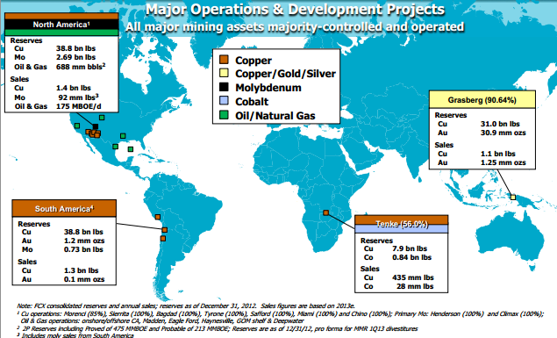
FCX Organizational Overview – Operations
http://www.fcx.com/operations/downloads/FCX_Global_Footprint_Final_APR13.pdf
http://www.fcx.com/index.htm
Notes:
Image retrieved from: http://www.fcx.com/operations/downloads/FCX_Global_Footprint_Final_APR13.pdf on January 2, 2014.
This is a pictorial of the major operations which FCX has world-wide. It also includes the main product reserves in each area.

Slide 5
Income Statement Comparison of 2012 to 2011
Revenue decreased by 13.75%
Net income for 2012 decreased by 30.7%
Total cost of sales increased by 5.9%
2012 Revenue similar to 2010 Revenue, however much higher costs in 2012.
Basic net income per share decreased by 33.5% to $3.20 per share.
http://www.fcx.com/index.htm
Notes:
FCX’s revenues decreased in 2012 over 2011 can mostly be accounted by the commodity price decrease in copper, decreased demand for copper out of the largest markets, and increase cost in extracting the metals out of lower ore grade product. The cost of sales also increased due to the extra labor required to extract the metals with the lower ore grade, so even though the revenue from 2012 mirrored 2010, the costs were significantly higher which drastically affects the bottom line. Net income per share of stock decreased, but not too drastically.

Slide 6
Income Statement
Google Finance, 2014
Quarterly Data
Annual Data
http://www.fcx.com/index.htm
Notes:
Image retrieved from Google Finance on January 1, 2014 at http://www.google.com/finance?q=NYSE%3AFCX&fstype=ii&ei=uprEUriKLq23iAKgzgE
This illustration is interesting, and can definitely spur more research. The quarterly data is trending where expected due to acquisition activity that happened in Q2 of 2013. The annual data shows a large negative value in the profit margin in 2008 (which was the first year after FCX acquired Phelps Dodge Corp. in 2007) and was also due to the large world recession that also drastically lowered demand for and thus prices for FCX’s main products. During the last 4 years of the annual data, the profit margins look to be very steady, even with cyclical commodity pricing and many capital projects undertaken.

Slide 7
Balance Sheet – Analysis Comparison of 2012 to 2011
Year over year:
Increase in current assets by 10.5%
Increase in receivables by 42.6%
Product inventories account for 48% of current assets in 2012, and 40.6% in 2011.
Increase in total current liabilities by 4.5%
Accounts payable increased by 5.9%
http://www.fcx.com/index.htm
Notes:
The reported balance sheet for FCX shows positive growth in current assets which outpaces the increase in current liabilities. This shows that the company’s endeavors to decrease debt and grow the business are headed in the right direction. The increase in accounts receivable (a summation of trade accounts, income taxes, and other accounts receivable) in 2012, which is money owed to the company, was 42.6% over 2011, whereas the accounts payable increased by only 5.9% year over year. Another interesting note is that product inventories accounted for 48% of current assets in 2012 and 40.6% in 2011 showing an increase in the value of the product, as well as increased production and stored inventory. Depending on market conditions, this inventory could be valued very differently if commodity prices shift drastically for their interested products.

Slide 8
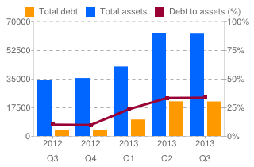
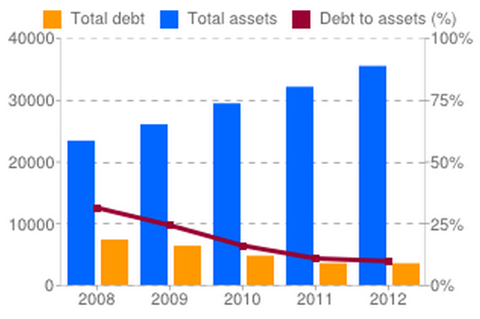
Balance Sheet
Google Finance, 2014
Quarterly Data
Annual Data
http://www.fcx.com/index.htm
Notes:
Image retrieved from Google Finance on January 1, 2014 at http://www.google.com/finance?q=NYSE%3AFCX&fstype=ii&ei=uprEUriKLq23iAKgzgE.
This illustration shows the year over year decrease in debt and increase in assets, while the quarterly data shows the opposite. The jump in debt in 2013 was the cause of the acquisitions completed that year, which should change the financial trend of year over year data from 2012 to 2013.

Slide 9
Cash Flow Analysis
Net cash flow from operating activities decreased by 30.7%
Net cash used for investing increased by 36.6%
Net cash used for financing activities decrease by 52.4%
Net decrease in cash flow over 2012.
http://www.fcx.com/index.htm
Notes:
Cash flow from operating activities decreased from 2011 to 2012, this was due, as stated previously, to market conditions in this commodity-based company. It is difficult to judge a company solely on year over year changes in cash due to the cyclical nature of commodities markets, and thus better analysis can be done through financial ratios which will be discussed later on.

Slide 10
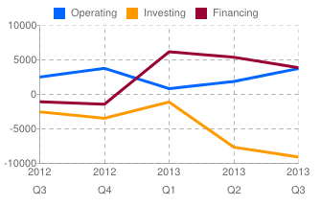
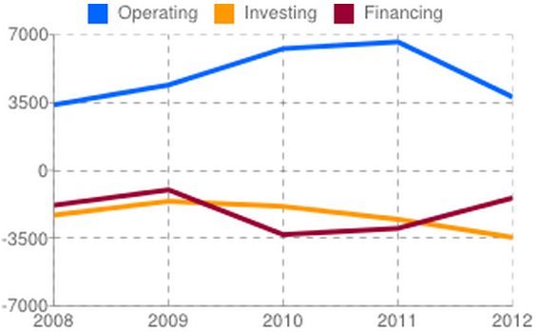
Cash Flow
Google Finance, 2014
Quarterly Data
Annual Data
http://www.fcx.com/index.htm
Notes:
Image retrieved on January 1, 2014 from Google Finance at http://www.google.com/finance?q=NYSE%3AFCX&fstype=ii&ei=3p_EUojfF8b9igLZJA.
This illustration is a pictorial of what has already been discussed previously, but has been included to show the comparison with the quarterly data. FCX made acquisitions in 2013 which is shown on the cash flow chart above starting in Q1 to Q2 of 2013, investing dollars climbing higher into the negative and financing climbing much higher into the positive. These acquisitions also helped to boost the operating cash flow higher by Q3 of 2013. It will be interesting to analyze 2013’s financial data when it becomes available over the next couple of months.

Slide 11
Auditor’s Statement of FCX Financials
“In our opinion, the financial statements …present fairly…the consolidated financial position of Freeport-McMoRan Copper & Gold Inc. at December 31, 2012 and 2011, and the consolidated results of its operations and its cash flows for each of the three years in the period ended December 31, 2012, in conformity with U.S. generally accepted accounting principles.”
- FCX 2012 Annual Report, p. 67
http://www.fcx.com/index.htm
Notes:
Nothings appears awry in the external audit of FCX’s financial reporting.

Slide 12
Financial Ratio Analysis
“Ratios are used to standardize financial information so that we can make comparisons” (Keown et al, 2014, p. 103).
Comparing FCX with a direct competitor, ADR (Rio Tinto).
Categories of Ratios:
Liquidity:
Ability to convert asset to cash quickly
Profitability
Debt
Investment Valuation
http://www.fcx.com/index.htm

Slide 13
Financial Ratios – FCX vs ADR
Liquidity Ratios
http://www.fcx.com/index.htm
Notes:
FCX appears to have sufficient liquidity to be able to pay its debts immediately with liquid assets. The current ratio shows an asset to liabilty ratio of 3 to 1, meaning that there are 3 times the amount of assets to cover all the company’s current liabilities. The acid-test ratio, or quick ratio, shows that there is also more than enough money in cash and accounts receivable to cover the company’s liabilities. Furthermore, the cash ratio also shows that FCX has enough cash and cash equivalents to cover all current liabilities without liquidating accounts receivable or inventories. Comparing FCX to ADR (Rio Tinto), it can be seen that for all 3 ratios, FCX is more liquid. It would be slightly concerning if ADR were to have to cover all current liabilities, the company would have to also liquidate part of its inventory to do so. Based on this, FCX appears as the better investment.

Slide 14
Financial Ratios – FCX vs ADR
Profitability Ratios
http://www.fcx.com/index.htm
Notes:
Analysis of FCX’s profitability ratios, mainly the gross profit margin, the operating profit margin, the return on assets, the return on equity, and the return on capital employed, shows that the company has realized lower profitability in 2012 than 2011, although still comparatively profitable versus ADR. This is not unexpected to see the year over year decline as was discussed previously, and a similar decline can be seen when analyzing ADR. Again, it appears as though FCX would be the better investment over ADR.

Slide 15
Financial Ratios – FCX vs ADR
Debt Ratios
http://www.fcx.com/index.htm
Notes:
Upon analysis and comparison of FCX’s debt ratios with ADR, it can be seen that FCX in 2012 seemed to have little change in debt ratios and capitalization ratios, and can amply cover the interest on its debt, and has adequate cash flow to cover all debt. ADR experienced a net loss in 2012, its debt and capitalization ratios are considerably higher, the company in 2012 would not have been able to even make interest payments on debt, and operating cash flow to debt was also concerning. As well here, FCX still appears to be the more attractive investment.

Slide 16
Financial Ratios – FCX vs ADR
Investment Valuation Ratios
http://www.fcx.com/index.htm
Notes:
For further comparison between FCX and ADR, a few investment valuation ratios were calculated, which included Price/Book Value Ratio, Cash Flow Coverage Ratio, Price/Earnings Ratio, and the Price/Sales Ratio. The price to book value ratio of FCX shows a decline in 2012 but illustrates that the market value of the stock is still more than double the book value of the stock, in addition it is significantly higher than ADR. The cash flow coverage ratio shows that the market price for the stock is more than 10 times the operating cash flow per share, meaning FCX stock is a good investment. The price/earnings ratio is also a great tool to determine what the prospective investor could hope to gain on investing in this stock, or what an investor would pay for a set amount of stock, which is also 10 times and shows a strong performance in 2012, even higher than 2011. Lastly, the price/sales ratio which reflects per dollar in company sales, how much investors are willing to pay, which for FCX is roughly double. While ADR is lower across the board for all of these ratios, it still is an attractive investment, although the negative price/earnings ratio in 2012 would possibly put off prospective investors.

Slide 17
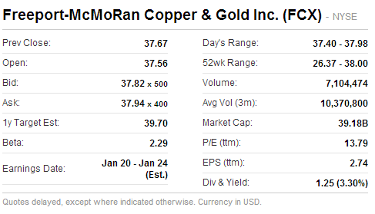
Stock Performance
Yahoo! Finance, 2014
http://www.fcx.com/index.htm
Notes:
Image retrieved from Yahoo! Finance on January 1, 2014 at http://www.google.com/finance?q=NYSE%3AFCX&fstype=ii&ei=3p_EUojfF8b9igLZJA.
This shows the stock performance of FCX stock as reported by Yahoo! Finance. The market price has increase even over 2012, as has the P/E ratio meaning that investors are currently willing to pay more per dollar of earnings than they were in 2012. This is encouraging for a prospective investor in this stock.

Slide 18
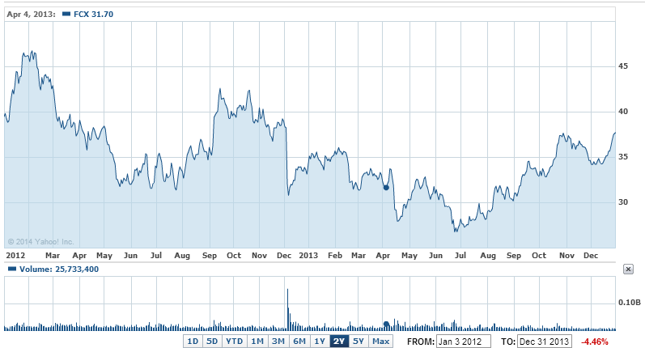
Stock Performance
Yahoo! Finance, 2014
http://www.fcx.com/index.htm
Notes:
Image retrieved from Yahoo! Finance on January 1, 2014 at http://www.google.com/finance?q=NYSE%3AFCX&fstype=ii&ei=3p_EUojfF8b9igLZJA.
It appears that the stock prices in 2012 had a steady decline throughout most of the year, and then began to turn around in Q3 of 2013, which could be directly correlated to the closing of acquisitions during that time.

Slide 19
Cost of Capital Analysis
Capital Asset Pricing Model (CAPM)
r = Required return on security
r_{f} = Risk free rate of return (2012 – 4.5%)
β = beta for security
r_{m} = Required return on market portfolio (2012 – 15.88%)
For FCX:
$$r=r_{f}+β×(r_{m}−r_{f})$$
$$r=4.5\%+1.61×\left(15.88\%−4.5\%\right)=22.82\%$$
http://www.fcx.com/index.htm
Notes:
The Capital Asset Pricing Model (CAPM) “…provides a basis for determining the investor’s expected or required rate of return from investing in a firm’s common stock” (Keown et al, 2014, p. 283). This calculation when used to compare firms or to determine what the expected rate of return for the company is wholly dependent on the beta value, or measure of associated risk, for the firm. FCX has a beta value of 1.61, which is very close to one of its competitors, Rio Tinto, at 1.57 (Google Finance, 2014). The expected rate, or required rate, of return for FCX stock is currently 22.82%. By this percentage being significanly higher than the current market rate of return, the investment appears to be promising. The calculation can also help in determining the weighted average cost of capital (WACC) as will be further discussed on the next slide.

Slide 20
Cost of Capital Analysis
Weighted Average Cost of Capital (k_{wacc})
r_{e}= required rate on equity (from CAPM)
E/V = Proportion of equity to equity + debt
r_{d}= market rate for debt payment
T_{c}= Corporate Tax Rate
D/V = Proportion of debt to equity + debt
For FCX:
$$k_{wacc}=r_{e}×\frac{E}{V}+r_{d}\left(1−T_{c}\right)×\frac{D}{V}$$
$$k_{wacc}=.2282×\frac{17543}{(3527+17543)}+.0235\left(1−0.275\right)×\frac{3527}{(3527+17543)}=19.3\%$$
http://www.fcx.com/index.htm
Notes:
The weighted average cost of capital is a tool widely used by investors to determine the average cost of capital and is dependent on the capital structure, or common stock, preferred stock, bonds, debt, as well as the mix of these different capitals. It is a weighted average where the rate of return or the rate of the after-tax interest is multiplied by the proportion of the corresponding capitals. For FCX, the WACC value is 19.3%, meaning that the realized average percentage of the company’s capital that is distributed to investors and debtors is 19.3 cents per dollar. Mathematically speaking, the easiest way to reduce the cost of capital for FCX would be to take on more debt. The multiplication factor for the debt proportion of this equation is much smaller than the equity portion of this equation. By increasing the amount of debt a company takes on in this case, would be a lower WACC. However, by further leveraging the company, this could have adverse reactions if the company appears to be over-leveraged, investors will sell the stock and the company could loose financial ground quickly. This is just one tool of many that investors must use when evaluating a company, as in the many other analyses that have been included within the presentation.

Slide 21
Valuation of FCX
Book value:
2012: $35.44B (+10.5%)
2011: $32.07B
Current is $38.74B (Google Finance, 2014) (+9.3%)
Common stock value:
Current: $37.32/share
2012: $33.14/share
2011: $36.79/share (Google Finance, 2014)
Notes:
Even with the cyclical pricing affecting the company’s bottom line, FCX’s book value has increased year over year by roughly 10%. Common stock value decreased in 2012, but 2013 has shown prices over than of 2011. The stock is doing rather well, and appears to be a sound investment opportunity.

Slide 22
Summary of Future Organizational Development
Continue to look for ways to further grow the business by expanding product portfolio through innovation & acquisitions.
Continue to look for innovative ways to cut costs and improve the bottom line.
Risks:
Producing too much supply in comparison to demand which will impact commodity prices and will great affect the bottom line.
Becoming too cash heavy could risk hostile takeovers/acquisition.
Continued union activity & increase in associated labor costs.
Notes:
FCX has a history of performing well financially and to continue to look for opportunities to invest and acquire some debt. The management within this company has been diligent in taking some risks, and growing which ultimately produces continued value for shareholders. It appears as if this company is doing everything right, and should continue to look for ways to invest its heavy cash flow back into the company, while maintaining some debt, which has a lower cost of capital than equity. Further more, the trend of increasing costs has to be reversed in order to impact the bottom line. Despite differing ore grades, and labor to produce the saleable products, innovation needs to be applied to reduce costs across the board. Many processes that are being used to extract minerals from the ore are technology that has been around for decades, with the same labor associated with them but at a higher cost due to inflation. Risks to be aware of and to avoid if possible is producing too much inventory or stocking too much inventory which could lead to price fluctuations within the market. Being one of the top producers in its market, FCX must maintain a balance that is constantly adjusted to market conditions. In addition, if the company becomes too cash heavy, it will be an attractive acquisition and could result in a hostile takeover, this must be combatted by continuing to invest and acquire technologies that are compatible with the company’s product portfolio. Lastly, the cost of labor disputes in the last couple of years have greatly increase labor costs especially in countries where the operating margin was much higher. Continuing to invest judiciously in employee development and enrichment as well as industry standard wages will help combat further union activity and keep costs down.
In conclusion, Freeport-McMoRan Copper & Gold Inc. is a sound company with sound management and a good investment. The company’s performance over the last couple of years has been impressive, and the continued growth within the company as well as acquisitions is a good omen for investors. Shareholders can expect to see better than market returns on their investments, which will keep capital flowing into the business. The financial concepts outlined in this presentation can give managers within this organization and others the tools to make decisions that will not negatively impact the value to shareholders which is the main objective for most businesses.

Slide 23
References
Freeport-McMoRan Copper & Gold Inc. 2013. 2012 Form 10-K. Retrieved from http://www.fcx.com/ir/downloads/2012_Form_10- K.pdf
Freeport-McMoRan Copper & Gold Inc. 2013. 2012 Annual Report. Retrieved from http://www.fcx.com/ir/AR/2012/FCX_AR_2012.pdf
Freeport-McMoRan Copper & Gold Inc. 2014. Our History. Retrieved from: http://www.fcx.com/company/history.htm
Freeport-McMoRan Copper & Gold Inc. 2014. Our Industry Standing. Retrieved from: http://www.fcx.com/company/industry_context.htm
Freeport-McMoRan Copper & Gold Inc. 2014. Who We Are. Retrieved from http://www.fcx.com/company/who.htm

Slide 24
References
Google Finance. 2014. Freeport-McMoRan Copper & Gold Inc. Retrieved from http://www.google.com/finance?q=NYSE%3A FCX&fstype=ii&ei=uprEUriKLq23iAKgzgE
Keown, A., Martin, J., & Petty, J. (2014). Foundations of Finance: The Logic and Practice of Financial Management (8th ed.) Upper Saddle River, NJ: Prentice Hall.
Rio Tinto. 2013. 2012 Annual Report. Retrieved from http://www.riotinto.com/reportingcentre2012/pdf s/rio_tinto_2012_annual_report.pdf
Yahoo! Finance. 2014. Freeport-McMoRan Copper & Gold Inc. Retrieved from http://www.google.com/finance?q=NYSE%3A FCX&fstype=ii&ei=3p_EUojfF8b9igLZJA.

Slide 25
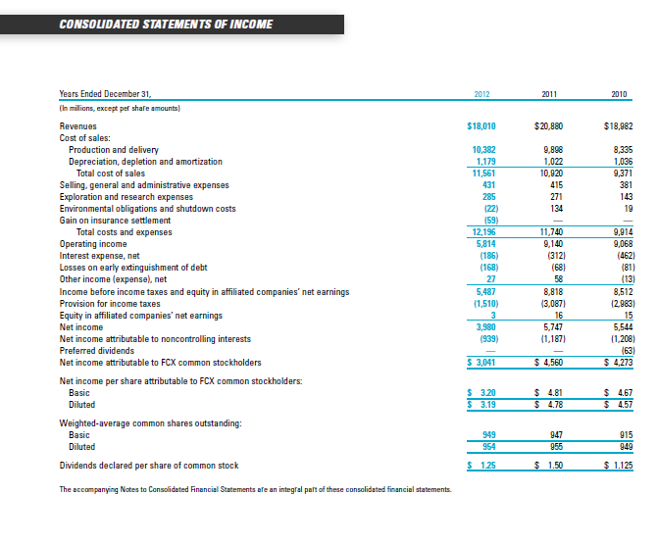
Appendices – FCX Income Statement

Slide 26
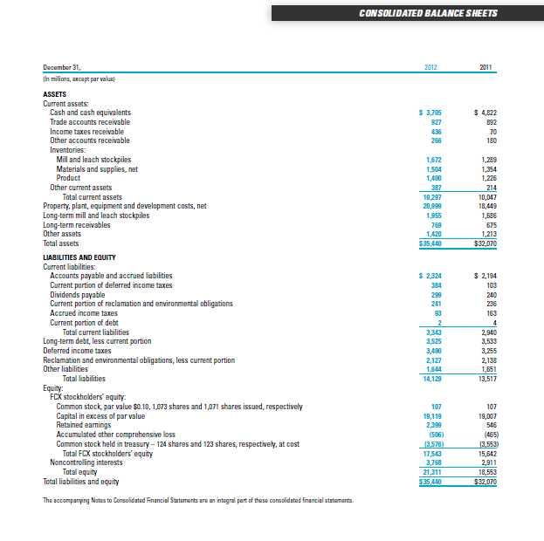
Appendices – FCX Balance Sheet

Slide 27
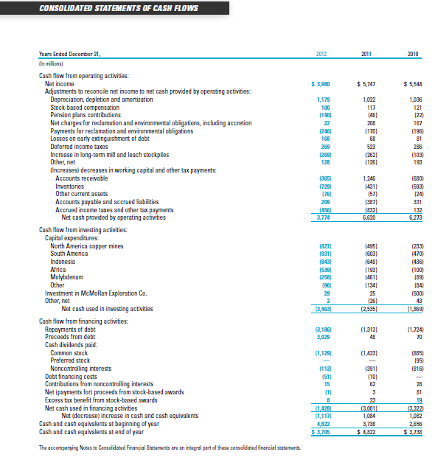
Appendices – FCX Statement of Cash Flows

Slide 28
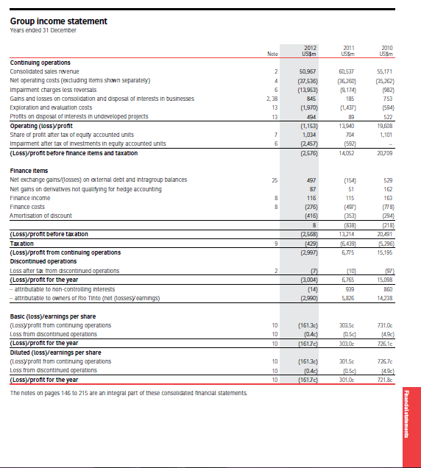
Appendices – APR Income Statement

Slide 29
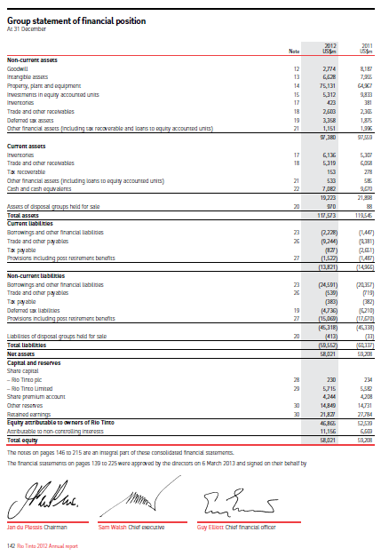
Appendices – APR Balance Sheet

Slide 30
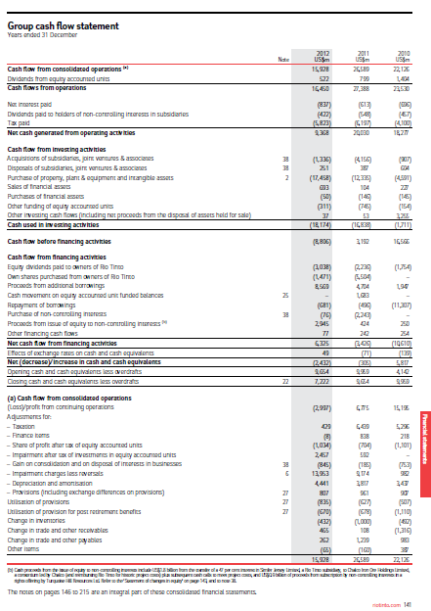
Appendices – APR Statement of Cash Flows

