Slide 1
Future of Organizational Behavior

Slide 2
Introduction
Continuing Education
How DaVita provides support to its employees for continuing education.
What is the future of organizational behavior
Organizational Behavior Challenges
What does the Future hold for DaVita
Conclusion

Slide 3
What is Organizational Behavior
Organizational behavior (OB) is the study of factors that affect how individuals and groups act in organizations manage their environment.
Notes:
Value of OB: Helps people attain the competencies needed to become effective employees, team leaders or managers.

Slide 4
The Importance of Continuing Education
Secure your Future
Gain a Competitive Edge
Become More Marketable
Economic Stability
Advance your Career
Notes:
Secure your future. People with higher levels of education tend to have better job security—and any credential you earn stays with you for life.
Gain a competitive edge. As more people continue their education, the competition for high paying, stable jobs will increase. Experience combined with education demonstrates to employers your motivation and drive to succeed
Become More Marketable In addition to a salary boost, skills training could be a bargaining chip in the promotion process Hiring managers offer higher entry-level salaries and more promotion opportunities to those with higher skill levels. Employers may even help fund your classes if you intend to stay with the company
Economic conditions are one of the main reasons driving demand for continuing education, and many people enroll in continuing education programs during recessions. Likewise, during recessions, many workers seek to
improve skills to remain hired or find new job opportunities
Advance Your Career Management and supervisory positions often require specialized skills. Developing the essential soft skills in communication, problem solving and critical thinking will help you move up the career ladder. Additionally, specialized positions could require specific skills training or the attainment of an industry accepted certification.

Slide 5
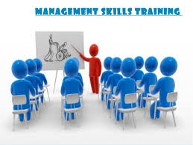
DaVita Continued Education Programs
Scholarship Programs
Tuition Reimbursement
DaVita Children's Foundation
Training Programs
Notes:
Redwood Scholars Award (Enhanced)
• Up to $25,000 per school year for full-time teammates (up to $5,000 per school year for part-time teammates) working toward a nursing, associate, undergraduate, graduate, Ph.D. or within an approved career path or other job-related degrees; teammates will share in the cost of their education.
• Awarded by the Award Selection Committee.
Tuition Reimbursement (Basic)
• Up to $3,000 reimbursed to full-time and part-time teammates per calendar year upon successful completion of job-related courses.
The DaVita Children’s Foundation, funded by DaVita, is a scholarship program offered to teammates' children and grandchildren who are enrolled in college or 12th grade and preparing for college entry. It awards scholarships of $1,000 to $3,000 to students who demonstrate outstanding leadership, community service or academic performance.​
DaVita’s Basic Training Program for In-center Hemodialysis provides the instructional preparation and the tools to enable teammates to deliver quality patient care. Our core values of service excellence, integrity, team, continuous improvement, accountability, fulfillment and fun provide the framework for the Program. Compliance with State and Federal Regulations and the inclusion of DaVita’s Policies and Procedures (P&P) were instrumental in the development of the program.

Slide 6
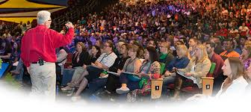
DaVita Academy
Provides Leadership Skills
Team Building
Improve Interpersonal skills
Communication
Notes:
DaVita Village and its unique culture; Identify ways to enhance your own leadership back at your own organization; Improve interpersonal skills such resolving conflict effectively, understanding your own communication style and how it impacts your personal/professional relationships; Network with DaVita Teammates as well as members of our executive team
Through this program, participants in the DaVita University Academy program learn what leadership looks like at DaVita as well as ways to use the concepts at home in their personal lives. Academy proves that fun doesn’t inhibit learning, it enhances it.

Slide 7
What is the future of organizational behavior
Manage Conflict
Employee Engagement
Be Able to Manage Stress
Culture & Strategy
Notes:
Workplace conflicts can emerge in any number of forms, but there are some general, garden-variety types that I see on a repeated basis: conflicts with the boss, conflicts with peers and conflicts among a manager’s direct reports or teammates. As a leader, you want to allow for a certain amount of creative tension, but the moment that conflict becomes counterproductive, you need to act. While the issues that cause conflict vary in importance, your relationships to teammates and the relationships among teammates must be functional if you hope to have a productive environment
Employee engagement is a concept that is generally viewed as managing discretionary effort, that is, when employees have choices, they will act in a way that furthers their organization’s interests. An engaged employee is a person who is fully involved in and enthusiastic about their work
Engaged employees are those who are performing at the top of their abilities and happy about it. According to statistics that Gallup has drawn from 300,000 companies in its database, 75%–80% of employees are either “disengaged” or “actively disengaged
Stress-Stress isn’t always bad. Stress within your comfort zone can help you stay focused, energetic, and able to meet new challenges in the workplace. Stress is what keeps you on your toes during a presentation or alert to prevent accidents or costly mistakes at work. But in today’s hectic world, the workplace can often seem like an emotional roller coaster. Long hours, tight deadlines, and ever increasing demands can leave you feeling worried, uncertain, and overwhelmed by stress.
When stress exceeds your comfort zone, it stops being helpful and can start causing major damage to your mind and body as well as your job satisfaction. But no matter what you do for a living, or how stressful your job is, there are plenty of things you can do to reduce your overall stress levels and regain a sense of control at work.
Culture & Strategy
Corporate culture is an incredibly powerful factor in a company’s long-term success. No matter how good a strategy is, when it comes down to it, people always make the difference
Corporate culture means different things to different people. It is emotional, ever-changing, and complex. Culture is human, vulnerable, and as moody as the people who define it.

Slide 8
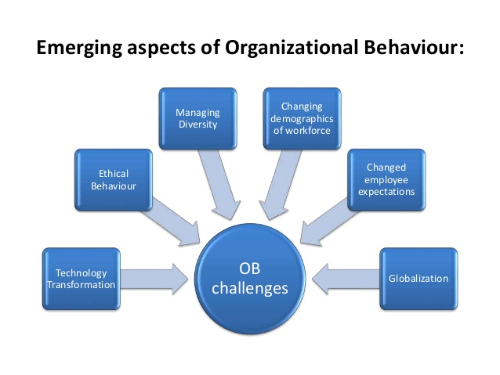
Organizational Behavior Challenges
Notes:
IT transformation is a complete overhaul of an organization's information technology (IT) systems. IT transformation can involve changes to network architecture, hardware, software and how data is stored and accessed.
Ethical behavior tends to be good for business and involves demonstrating respect for key moral principles that include honesty, fairness, equality, dignity, diversity and individual rights.
Managing Diversity-Working with people from very different backgrounds can be stimulating and educational. When you're the manager of a diverse staff, the essential tools are keeping an open mind, being alert to any discomfort among employees, and developing sensitivity to cultural variations
Important demographic trends will take place in the workforce over the next 10-15 years-The population and labor force will continue to diversify, as immigration continues to account for a sizable part of population growth
Changed employee expectattions-Managers and supervisors often need additional training and resources to deal with changing workforce values. Interpersonal and behavioral skills, workshops and communication techniques seminars are increasingly offered to help translate changing workplace values into business practice.
Globalization-Globalization has many dimensions. The most general is the economic globalization. OB studies are now increasingly becoming complex due to the effect of globalization.

Slide 9
DaVita's Future
Continue to provide Quality Patient Care
Qualified Providers
Provide Equal Opportunity Employment
Continue to Donate to Kidney Disease
Notes:
We make a difference in each patient’s life by providing quality care. We treat all patients with
warmth, respect and dignity, providing care that is both medically necessary and appropriate. We
involve patients in treatment planning and decisions affecting their care whenever appropriate.
Davita is committed to providing a workplace that is diverse and free from improper discrimination
and harassment. They hire and promote teammates based on their ability to demonstrate excellence
in their work and dedication to meeting our patients’ needs
Donating to kidney disease charities is a great way to show your support for people who have chronic kidney disease (CKD), are on dialysis or have had a kidney transplant. These charities exist to raise funds for education, research, prevention and screenings.

Slide 10
Conclusion

Slide 11
References
https://www.davita.com/kidney-disease/overview/living-with-ckd/5-ways-to-donate-to-kidney-disease-charities/e/7699
Borkowski, N. (2016). Organizational behavior, theory, and design in health care.

