Slide 1
Tobacco Program Coalition
Karanda Farmer, Aminha Howell,
Carlia Oldfather & Mercedes Pellegrino
June 1st, 2016
BSHS/485
Tim Duncan

Slide 2
Table of Content
Introduction
History of Coalition
Core Values of Coalition
Need that Propelled Coalition
Vision
Mission
Purpose
Steps to Develop Coalition
Implementation Steps
Implementation Process
Steps to Sustain Coalition
Sustaining Coalition in Community
Benefit of Coalition in Other Communities
Conclusion
References
Questions

Slide 3
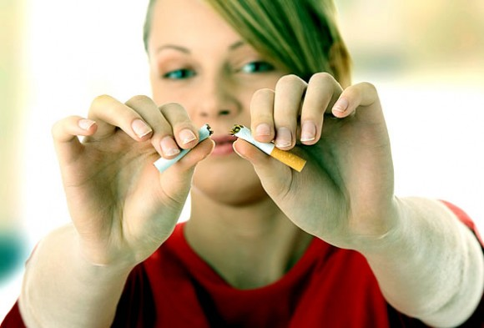
Introduction
Notes:
A coalition is defined as “a group of individuals and/or organizations with a common interest who agree to work together toward a common goal” (Community Tool Box, n.d., para. 2). A community coalition is when these individuals and/or organizations come together to make their communities stronger, safer, and healthier. According to the Cancer Research UK (n.d.), academic research and scientific studies supports that:
Tobacco Is the biggest cause of cancer
Occasional smoking is also harmful
Smokeless tobacco, pipes, cigars, bidis and shisha also cause cancer
Chemicals in the smoke are harmful to the body
Smoking cigarette is the cause of one in five deaths in the United States, making it the number one cause of death in the United States that can be prevented (Centers for Disease Control and Prevention, n.d.). Because all of the health risks that are connected with tobacco use, a community coalition must be developed: The Tobacco Program Coalition. This presentation seeks to describe the steps taken to develop, implement, and ensure sustainability of a Tobacco Program Coalition.

Slide 4
History of Coalition
XX
Notes:
Aminha

Slide 5
Core Values of Coalition
XX
Notes:
Aminha

Slide 6
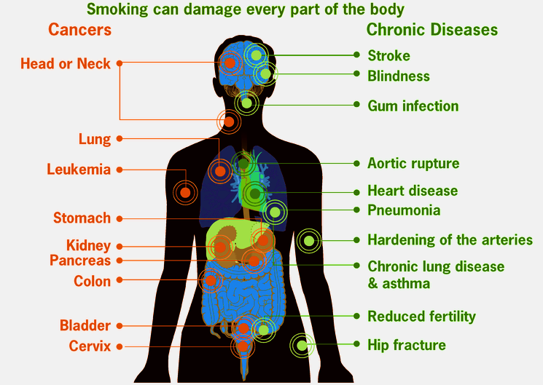
Need that Propelled Coalition
Lower health risks
Lower amount of tobacco users
Awareness to others
Notes:
When it comes to this specific coalition there are three key factors that propelled the coalition (Center for Disease Control and Prevention, 2016). The first key is to lower health risks to individuals and ones around the tobacco user. There are tobacco related diseases that can cause health problems, disease, and death. The coalition is trying to lower the amount of cancer, heart disease, strokes, respiratory symptoms, and infertility among individuals and groups. Lowering the amount of health risks can in turn lower the amount of tobacco users simply because he, she, or they are more aware of what the potential risks could be. The coalition is trying to bring awareness to massive amounts of people to help with the overall reduction of tobacco usage (Center for Disease Control and Prevention, 2016).

Slide 7
Vision
Promote, encourage and foster healthy lifestyles that will help build a healthier and stronger community by ensuring an environment free of tobacco use.
Notes:
The vision of the coalition is to:
Promote, encourage and foster healthy lifestyles that will help build a healthier and stronger community by ensuring an environment free of tobacco use.

Slide 8
Mission
Prevent tobacco use, promote and support cessation of tobacco use in the community through collaboration, education of health risks and benefits of cessation, and policy change while providing cessation support to the community.
Notes:
The mission of the Tobacco Program Coalition is to:
Prevent tobacco use, promote and support cessation of tobacco use in the community through collaboration, education of health risks and benefits of cessation, and policy change while providing cessation support to the community.

Slide 9
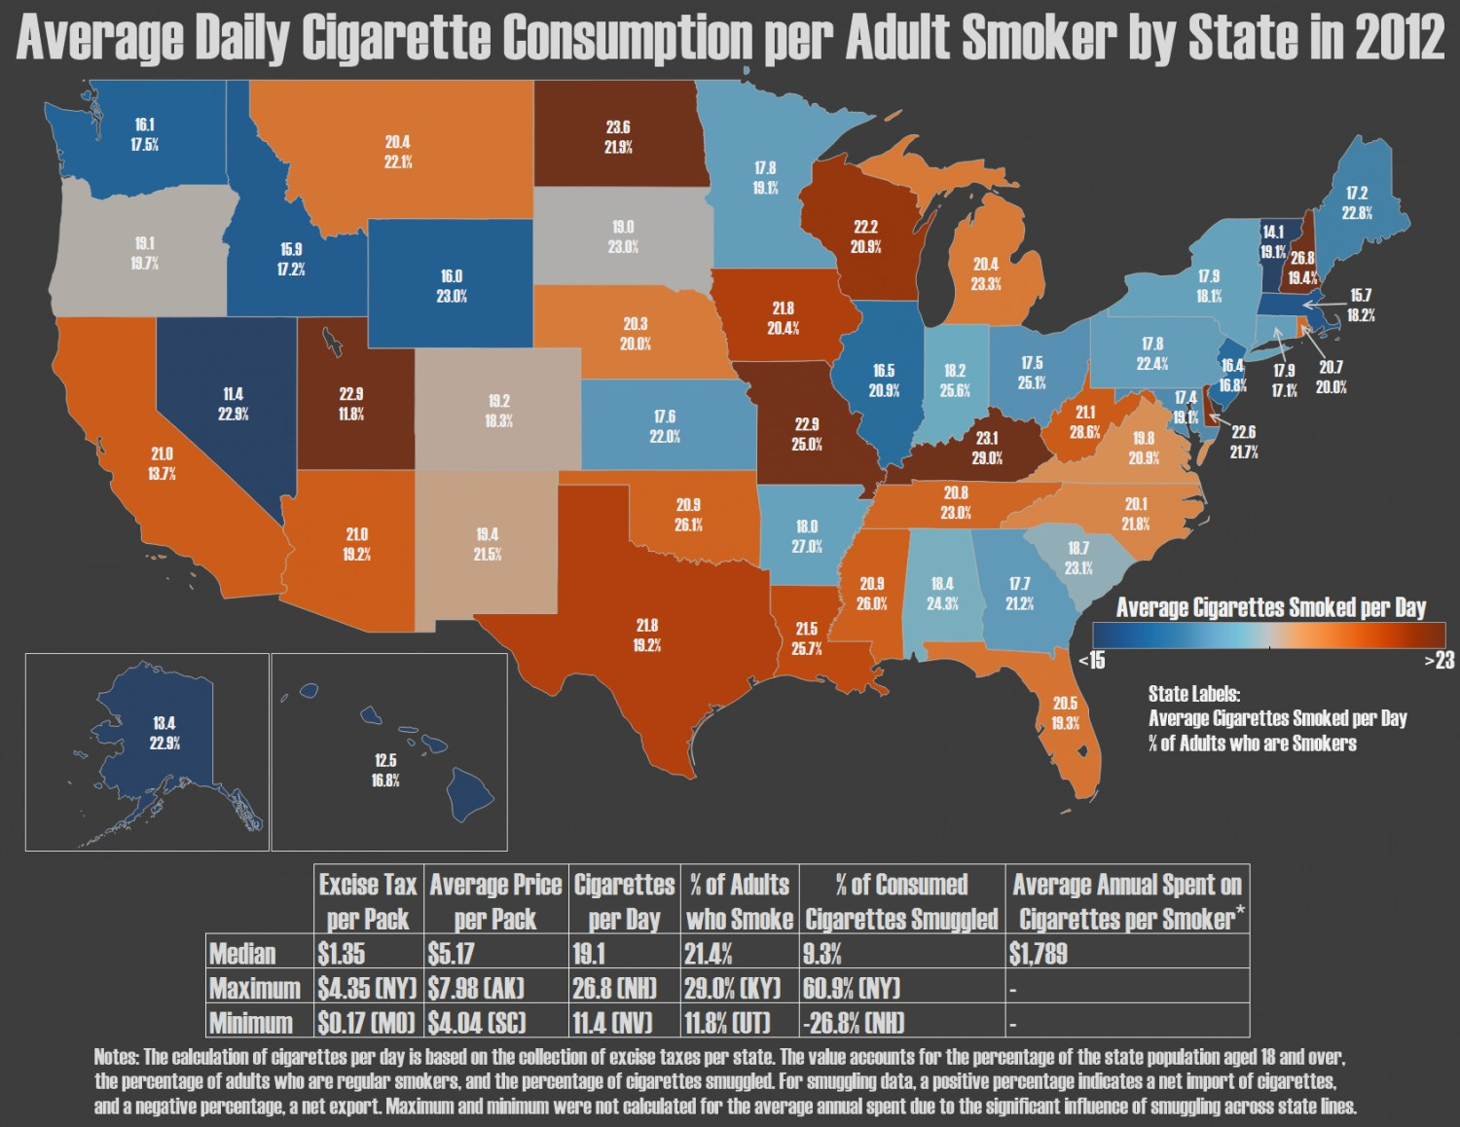
Purpose
Awareness
Reduce tobacco disease
State data and statistics
Guidelines
Resources
Notes:
The purpose of the coalition is to help bring awareness to the harms of tobacco usage (Center for Disease Control and Prevention, 2016). The awareness can start off small but can grow into something much bigger. With awareness comes the reduction of tobacco related diseases simply because individuals can be more likely to stop using tobacco if found severely harmful. Another purpose of the coalition is to gather state data and overall statistics of tobacco usage, disease, and dependency. There needs to be guidelines put in place by the coalition in order to help individuals and groups with what he or she can or cannot do. Finally resources can be an important part of a coalition because the resources can be just as helpful as the coalition but in a different aspect (Center for Disease Control and Prevention, 2016).

Slide 10
Steps to Develop Coalition
XX
Notes:
?

Slide 11
Implementation Steps
Checklist for the staff and key leaders
Reaching out to the potential members
Educating the potential members about the coalition
Giving the potential members and offer
Notes:
The checklist of the stuff and key leaders will see to it that the coalition is ready to operate and have everything in place before getting new members. This will see to it that they get the commitment of the group as whole. Educating the potential members will involve giving them the information about the coalition in order for them to see how they are likely to benefit from joining the group.

Slide 12
Implementation Process
Defining the mission and vision of the coalition
Description of the coalition by laws and procedures
Descriptions of the role of the coalition
Developing work group plans
Notes:
The above processes will see to it that the coalition is developed in the right track in accordance with the plan. It will also enable the member to get to know the main reason why the coalition was formed so as to undertake their duties and responsibilities in a manner that will see to it that the coalition achieves its main objectives.

Slide 13
Steps to Sustain Coalition
Members engagement
Planning the work and working the plan
Offer training for the leaders and members
Organizing group conferences
Notes:
Engaging the members will see to it that they are involved in the activities of the coalition directly and as such feel a sense of belonging. As such they will continue working with the coalition to achieve its agenda. Planning the work and working the plan will see to it that the coalition is able to achieve its goals and objectives. Training and conferences are very effective ways of educating the staff as well as the member on the most effective practices that will result to the success of the organization as a whole.

Slide 14
Sustaining Coalition in Community
For sustainability, the coalition needs to:
Function effectively and efficiently
Remain diverse
Produce the desired results
Notes:
It would be very unfortunate if the coalition is formed and a few weeks down the line it collapses. The above factors will see to it that the coalition does not come to an end prematurely until it has been able to achieve the objectives for while it was developed to bring forth. Diversity is about including very individual in the community so a to make it have a balanced membership without bias.

Slide 15
Benefit of Coalition in Other Communities
Leader and advocate
Knowledge transfer and translation
Broker of relationships
Developer of standards
Evaluator
Monitor
Notes:
When it comes to how the coalition can benefit other communities there are six ways such as being a leader and advocate for the overall health and wellbeing of the community members by different approaches and strategies (Batan, Butterfoss, Jaffe & LaPier). Having knowledge is very beneficial simply because the coalition can offer sound information for the aspiring tobacco free community. The broker of relationships is helpful to other communities because the coalition will have partnerships with other communities, agencies, and businesses. When it comes to the standards it is key that the coalition stay within local, state, and national guidelines. These standards can be helpful to the learning communities in order to stay professional and legal. The coalition helps with evaluations by allowing other communities to know and understand what does and does not work with or for the coalition. Finally, the monitor helps to keep track of the coalition’s progress while making necessary changes or suggestions to better the coalition (Batan, Butterfoss, Jaffe & LaPier).

Slide 16
Conclusion
XX
Notes:
Aminha

Slide 17
References
A sustainability planning guide for healthy communities (n.d.). Centers for Disease Control and Prevention. Retrieved from http://www.cdc.gov/nccdphp/dch/programs/healthycommunitiesprogram/pdf/sustainability_guide.pdf
Coalition building I: Starting a coalition (n.d.). Community Tool Box. Retrieved from http://ctb.ku.edu/en/table-of-contents/assessment/promotion-strategies/start-a-coaltion/main
Coalitions: State and community interventions (2007). Centers for Disease Control and Prevention. Retrieved from ftp://ftp.cdc.gov/pub/fda/fda/user_guide.pdf
Health effects of cigarette smoking (n.d.). Centers for Disease Control and Prevention. Retrieved from http://www.cdc.gov/tobacco/data_statistics/fact_sheets/health_effects/effects_cig_smoking/
Pyles, L. (2009). Progressive community organizing. New York, NY: Routledge.
Quitting smoking (n.d.). Centers for Disease Control and Prevention. Retrieved from http://www.cdc.gov/tobacco/data_statistics/fact_sheets/cessation/quitting/index.htm
Smoking facts and evidence (n.d.). Cancer Research UK. Retrieved from http://www.cancerresearchuk.org/about-cancer/causes-of-cancer/smoking-and-cancer/smoking-facts-and-evidence#smoking_facts13
Tobacco control programs (n.d.). Centers for Disease Control and Prevention. Retrieved from http://www.cdc.gov/tobacco/stateandcommunity/tobacco_control_programs/index.htm

Slide 18
Questions

