Slide 1
Research Grants and Contracts
William S. Messer, Jr., Ph.D.
Vice President of Research
The University of Toledo
April 1, 2016

Slide 2
Overview
A Brief History of Federal Research Funding
Funding Sources
Research Support Mechanisms
Research Proposals
NIH Submission
Peer Review
Funding Process

Slide 3
Funding in the 19th Century
1803 – Jefferson asked Congress to authorize $2,500 for Lewis & Clark’s largely scientific expedition to Northwest Territory
Federal support was largely for mission-oriented research in agriculture, defense, and national resources
Conducted by government labs
1876 – Founding of Johns Hopkins University
Integration of German research university and English undergraduate college
Recognized as the beginning of university-based research in U.S.
University research primarily supported by private agencies and university funds
Prior to WWII, the federal government provided little support for university-based research

Slide 4
World Wars I and II
During WWI, university scientists were drafted into the military to perform research at military installations
During WWII, university scientists worked in their own university labs on federally funded research in support of the war effort
Federal government agreed, via research contracts, to compensate universities for both the direct and indirect costs of research
A sense of mutual obligation and trust emerged between universities and the government
Institutions could reasonably expect continued funding if they produced quality efforts and results from government-financed programs

Slide 5
World War II
In November, 1944, President Roosevelt wrote to Vannevar Bush, Director of the Office of Scientific R&D, asking for an assessment of US research funding
“New frontiers of the mind are before us, and if they are pioneered with the same vision, boldness and drive with which we have waged this war, we can create a fuller and more fruitful employment and fuller and more fruitful life.”
Focus on economic strength after war

Slide 6
Bush Report
Broad message:
Science and technology bring great rewards to society – good jobs, a higher standard of living, and better health.
Discovery is unpredictable, so we must invest in a broad portfolio of research or America will fall behind its world competitors.
“Without scientific progress, no amount of achievement in other directions can insure our health, prosperity, and security as a Nation in the modern world.”
Reaffirmation of compensation for full cost of research (direct and indirect costs)

Slide 7
Key Milestones
1930 – “Laboratory of Hygiene” (founded in 1887 with $300 budget) was renamed “National Institute of Health”
One room office
1945 – V. Bush’s plan implemented
Government spent $31 Million on research
1950 – National Science Foundation (NSF) founded
1965 – Government spent $1.6 Billion on “General Science and Basic Research, and Health Research and Training”
>50-Fold increase in 20 years
2016 – NIH budget is $31.3 Billion (up 3.3% from 2015)
>19x the total 1965 government research expenditure

Slide 8
Emerging Philosophy
In the university setting, scientific education and research are inseparable

Slide 9
Funding Sources
Federal government
State governments
Private / Non-profit organizations
Corporations

Slide 10
Federal Research Agencies
Department of Health and Human Services
National Institutes of Health (NIH)
National Science Foundation (NSF)
National Oceanic and Atmospheric Administration (NOAA)
Environmental Protection Agency (EPA)
National Aeronautics and Space Agency (NASA)
Department of Energy
Department of Defense
Department of Education
Department of Justice
Others

Slide 11
Funding Mechanisms
Assistance mechanisms
Grants
Cooperative Agreements
Procurement mechanisms
Contracts

Slide 12
Research Grant
Financial assistance mechanism whereby money and/or direct assistance is provided to carry out approved activities
Usually investigator-initiated
Relatively flexible
Governed by “Grants Policy”

Slide 13
Cooperative Agreement
A support mechanism that will have substantial federal scientific and/or programmatic involvement
After award, government scientific or program staff will assist, guide, coordinate, or participate in programmatic activities beyond the normal stewardship responsibility in the administration of grants
Proposed cooperative agreements will be published as policy announcements, program announcements, or requests for applications (RFA)
Now called Funding Opportunity Announcements (FOA)

Slide 14
Research Contract
Legal instrument used to reflect a relationship between the Federal Government and the recipient whenever the principal purpose of the transaction is to acquire goods or services for the direct benefit or use of the Government
Types
Fixed-price and cost-reimbursement
Agency-initiated (published RFPs – responses are bids)
Relatively inflexible (work statements/task orders & deliverables)
Federal contracts are governed by FAR (Federal Acquisition Regulations)
Same rules as defense contractors must use

Slide 15
Institutional Responsibility
Institution, not the Principal Investigator (PI), is grantee/contractor
The PI is the one individual designated by the applicant organization to direct the project or program to be supported by the grant
The principal investigator is responsible and accountable to applicant organization officials for the proper conduct of the project or program
Multiple PIs also are recognized
Management plan for multiple PIs
The institution is legally responsible and accountable to agency

Slide 16
Allocated Costs
Grant costs (i.e., the money that comes to the university) are often broken out into two components:
Direct costs
Indirect costs (aka Facilities and Administrative or F&A)

Slide 17
Direct Costs…
“…any cost that can be specifically identified with a particular project, program, or activity or that can be directly assigned to such activities relatively easily and with a high degree of accuracy”
“…include, but are not limited to, salaries, travel, equipment, and supplies directly benefiting the grant-supported project or activity.”

Slide 18
Indirect Costs
“Costs that are incurred by a grantee for common or joint objectives and that, therefore, cannot be identified specifically with a particular project or program.”
Includes many common needs to run a research institution: buildings, core labs, lab renovations, utilities, animal facilities, research equipment, compliance programs (IRB, IACUC), general support staff, etc.

Slide 19
Indirect costs
Institutions negotiate with the federal government to determine their indirect cost rate at 4-year intervals
UT rates:
Health Science Campus – 51.5%
Main Campus – 47.5%
For every $100 of direct costs on a NIH grant, NIH pays UT $51.50 if the work is conducted on the HSC
Federal indirect cost rates rarely apply to non-federal agencies

Slide 20
Allowable Costs
Mandated by Office of Management and Budget Circular A21 (OMB A-21): “Cost Principles for Educational Institutions”
<http://www.whitehouse.gov/omb/circulars_a021_2004>

Slide 21
National Institutes of Health
Notes:
http://upload.wikimedia.org/wikipedia/commons/0/00/NIH_Clinical_Research_Center_aerial.jpg

Slide 22
NIH Research Programs
Intramural programs
Laboratories primarily at the campus in Bethesda, MD
~10% of the NIH budget
Extramural programs
Research funding for research laboratories throughout the U.S. and the world.
~80% of the NIH budget

Slide 23
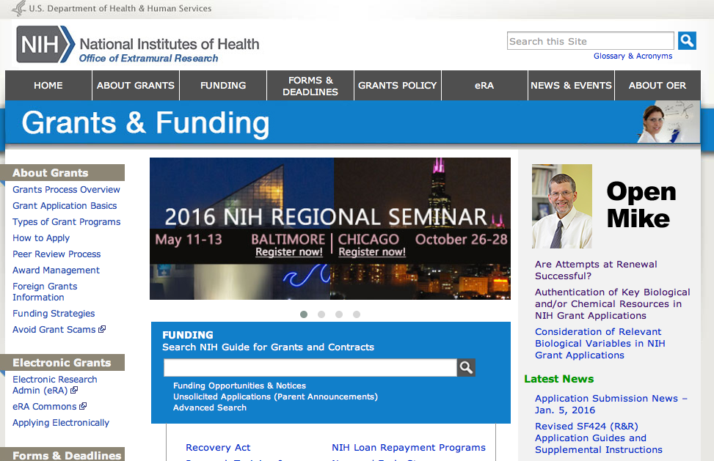
Grants.gov
http://grants.nih.gov/grants/oer.htm

Slide 24
NIH Extramural Programs
Indiv. MD/PhD Training (F30)
Indiv. PhD Training (F31)
Inst. Pre-Doc Training Grant (T32)
Mentored Career Dev. Grants (K01, K08)
Independent Scientist Development (K02)
Small Research Grant (R03)
Exploratory/Development Grant (R21)
Research Project Grant (R01)
Program Project (P01)
Postdoctoral
Training Support
(T32, F32)
Senior
Fellowship
(F33)
Transition to
Independence
(KO1)
Stages of
Research Training
and Career
Development
Graduate
Student
Mid-
Career
Change
Post-
Doc.
Career
Review Guidelines For Specific Proposal Types
<http://www.csr.nih.gov/guidelines/guidelines.htm>
Victor A. Fung, Ph.D
SRA - NIH

Slide 25
Grant Proposals
Proposal preparation
Submission overview

Slide 26
Advice
You have to write a grant to get money.
“You never score on the shots you don’t take”
Wayne Gretzky
“The only grant that you are certain not to get is the one that you do not write.”
It takes time and effort to write a grant – so do it right!
“There is no grantsmanship that will turn a bad idea into a good one, but…there are many ways to ‘disguise’ a good one”
William Raub, Past deputy director of NIH
It is the obligation of the investigator to communicate ideas and research plan clearly to application reviewers

Slide 27
Grant Proposals
Process
Idea or observations (hypothesis)
Preliminary experiments to generate data
Refine idea/hypothesis
Write – edit – rewrite – edit – rewrite
Intramural reviews
Colleagues (peer review begins at home)
Departmental review and approval
Institutional Review (Research & Sponsored Programs)
Submit final application
NIH grant writing tips:
<http://grants.nih.gov/grants/grant_tips.htm>

Slide 28
NIH Application Components
Cover pages: name, institution, etc.
Modular budget and justification
Research strategy
Introduction: for a resubmission*
Specific Aims
Research plan
Significance
Innovation
Approach
Preliminary results/progress report**

Slide 29
NIH Application Components
Other research plan sections:
Human subjects
Vertebrate animals
Select agents
Multiple PI leadership plan
Letters of support
Consortium/Contractual Arrangements
Resource sharing plan
Research and Sponsored Programs must review all proposals!

Slide 30
Signature

Slide 31
Institutional Responsibility
The institution is the grantee
The institution must ensure that proposal complies with agency & institutional policies & regulations
Responsibilities include:
Representations, certifications, and assurances
Providing necessary resources (lab space, etc.)
Regulatory compliance (IACUC, IRB, BioSafety)
Budget accuracy
Personnel time & effort
Reviewing potential conflicts-of-interest, etc.

Slide 32
Institutional Responsibility
Research and Sponsored Programs must review each application (not just sign document)
Reviews take time
Issues need to be addressed before submission
Often other investigators are submitting for the same deadline
Submit materials early!
Messer’s law:
You have to plan ahead to wait until the last minute

Slide 33
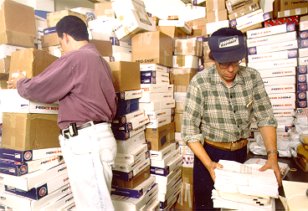
The Good Old Days…
Is Your Application In Here?? Maybe It’s This One!

Slide 34
The Good Old Days…
I’ll bet this one is yours!

Slide 35
…Welcome To The New Age
Electronic submission!
Through Grants.gov
Common portal for submitting applications to all federal agencies
Individual agency systems
NSF – FastLane
<https://www.fastlane.nsf.gov/fastlane.jsp>
NIH – eRA Commons
<https://commons.era.nih.gov/commons/>
proposalCENTRAL
<https://proposalcentral.altum.com>

Slide 36
Grants.gov
<http://grants.nih.gov/grants/oer.htm>

Slide 37
Peer Review
Dual review system
Scientific review group (SRG)
Provides initial review for scientific merit
Rates applications and makes recommendations for appropriate level of support and duration
Council
Assesses quality of SRG review of grant applications
Makes recommendations to institute staff on funding
Evaluates program priorities and relevance
Advises on policy

Slide 38
NIH Grant Process
Submission, receipt, and assignment of application
SRG review and evaluation for scientific merit
Program staff and council review; funding decision for scored applications
Award negotiation and issuance
Months 1-3
Months 3-7
Months 8-9
Months 9-10

Slide 39
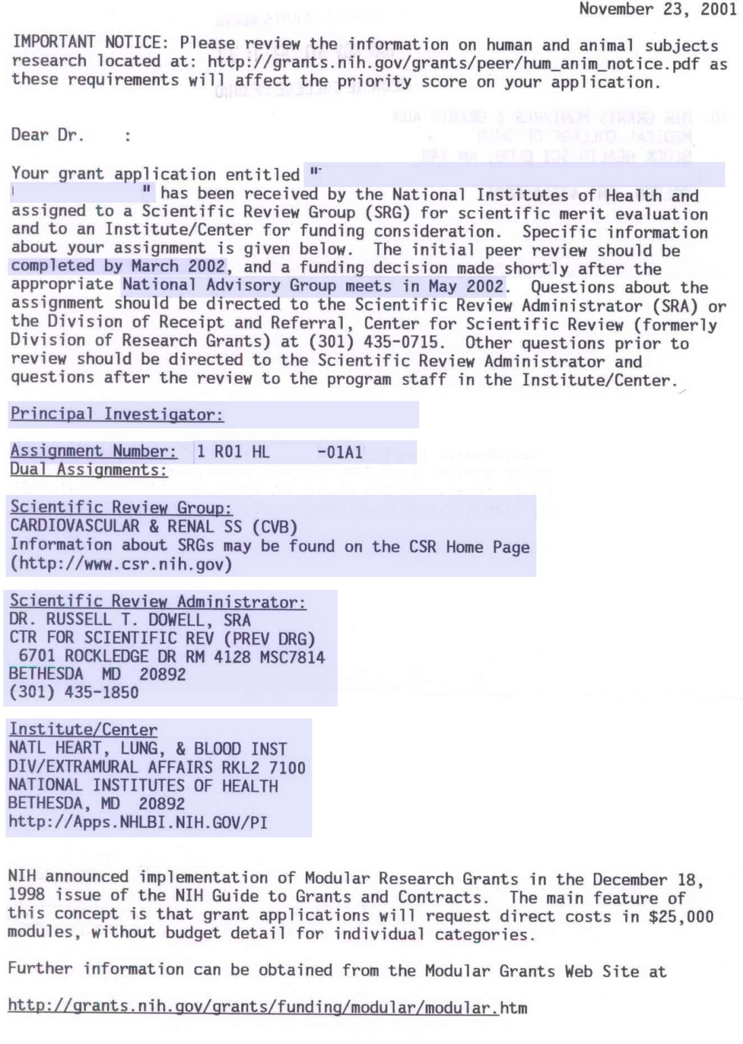
Study Section Review
Assignment to study section
Scientific Review Group
Scientific Review Administrator

Slide 40
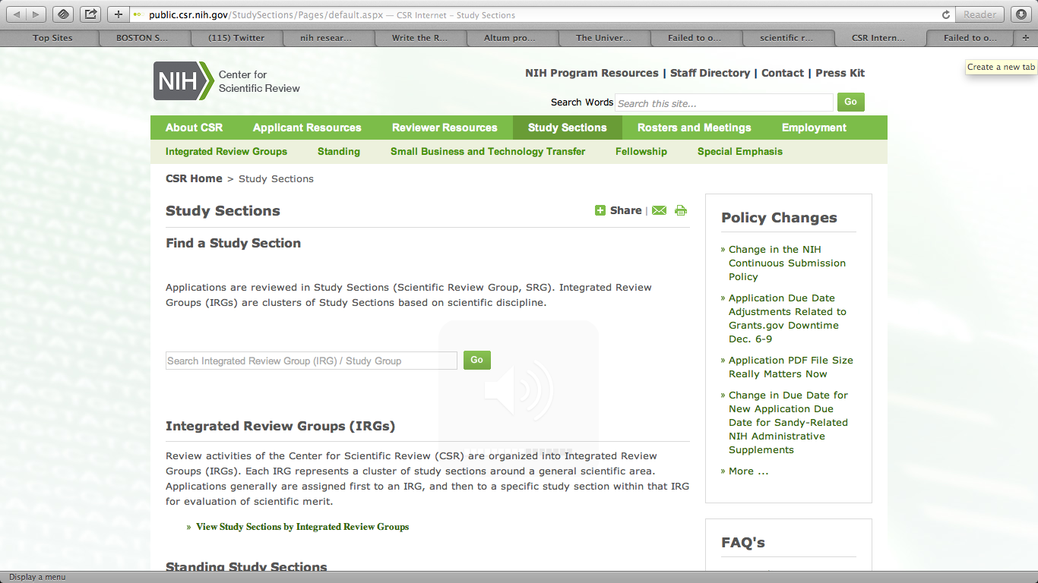
Study Sections
<http://public.csr.nih.gov/StudySections/Pages/default.aspx>

Slide 41
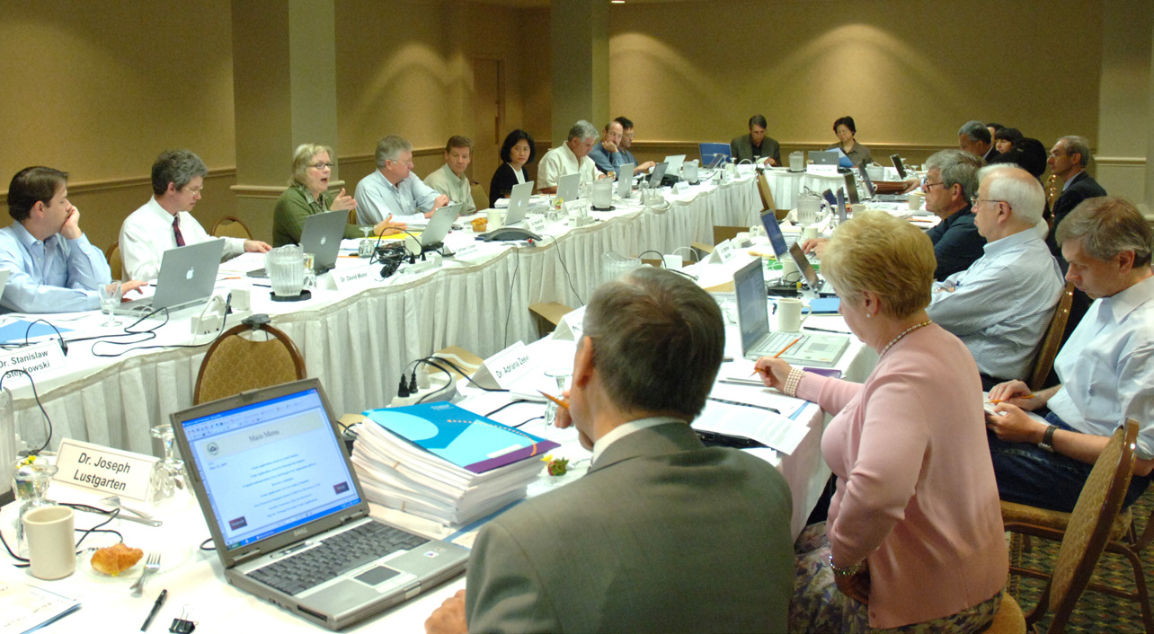
Study Section in Action
Notes:
http://nihrecord.od.nih.gov/newsletters/2010/04_16_2010/story7.htm

Slide 42
Study Section Members
Mostly academic scientists
Active researchers (almost always NIH funded)
Good scientists but probably not in your “niche”
They all have “day jobs”
They review these applications in their “spare time”
Paid $150/day + expenses for meeting days only
Regular members & ad hoc members
Review many applications each cycle, so careful application preparation is valued
Make it easy for them!
Never assume that they will know what you mean!

Slide 43
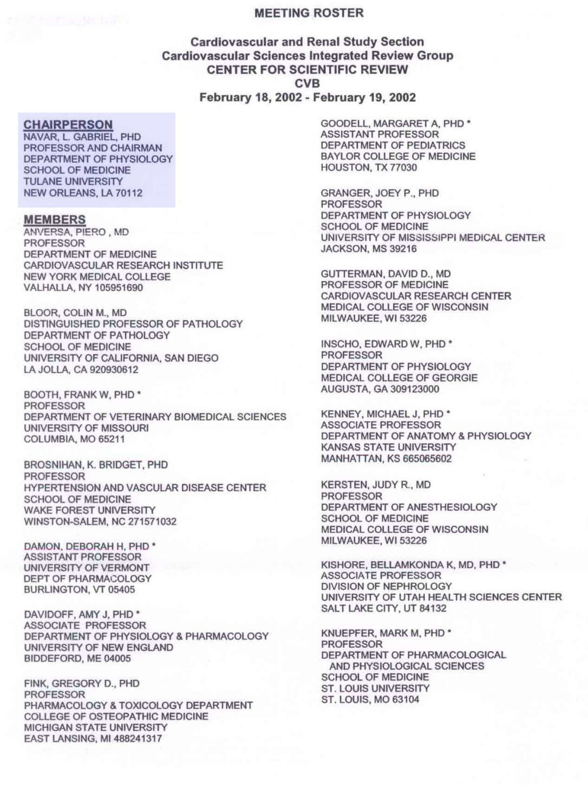
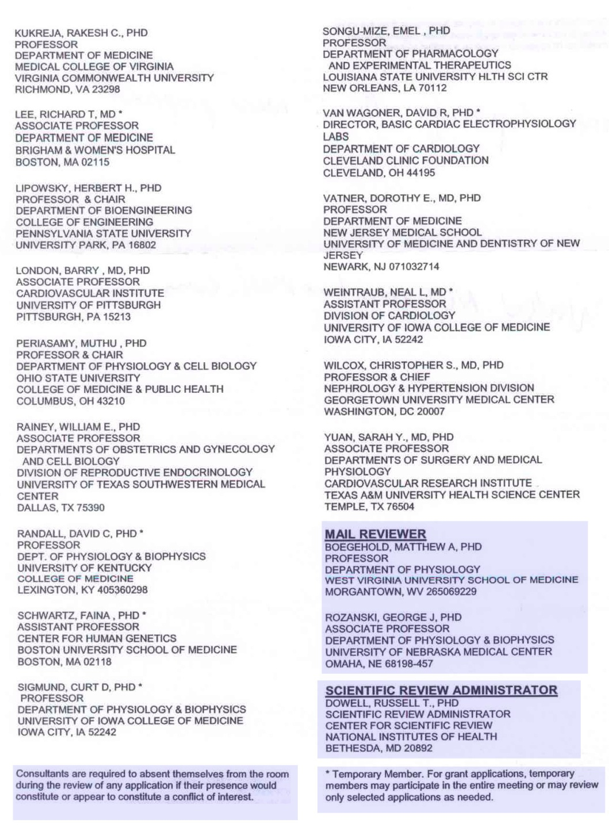
Study Section Roster

Slide 44
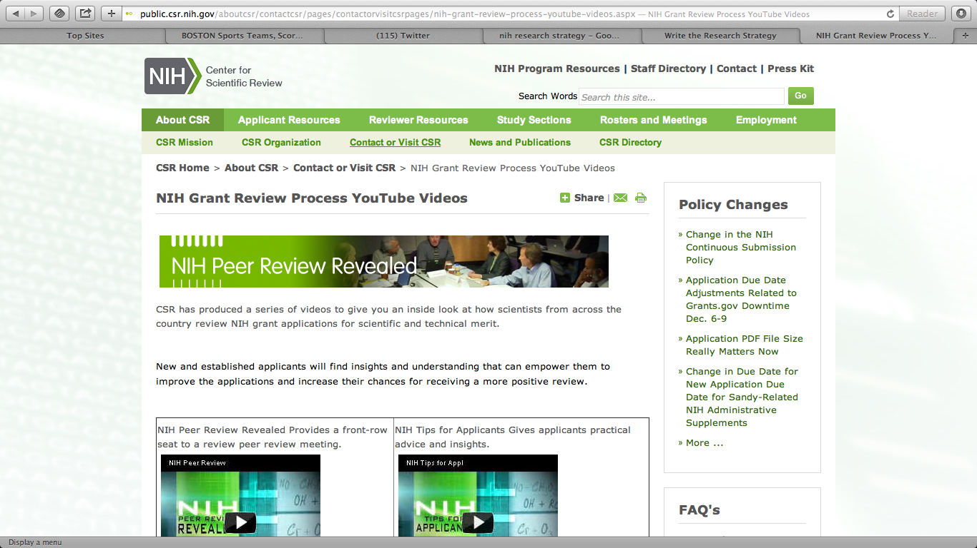
Inside Study Sections
<http://www.csr.nih.gov/Video/Video.asp>

Slide 45
Study Section Meetings
Closed – meetings are confidential
Orientation
Conflict-of-interest
Developments of interest to the study section (NIH News)
Changes in policy or procedure
Introductions and roles of persons present
Preliminary ranking and list of applications that will not be discussed
Application-by-application review
Persons with potential conflicts-of-interest excused
Discussion of each application’s scientific and technical merit
Assigned reviewers read reviews first, then other members discuss
Range of scores set (assigned reviewer scores very important)
Every member scores every application by secret ballot
After voting (so as to not affect priority score):
Human subjects & vertebrate animal concerns
Recommended changes to budget

Slide 46
Confidential Process
It is inappropriate to communicate with members of a study section about an application
Before, during or after meeting
Get to know members and talk with them about everything else
Call SRA or program officer with questions about the review

Slide 47
Review Criteria
Significance:
Does this study address an important problem? If the aims of the application are achieved, how will scientific knowledge be advanced? What will be the effect of these studies on the concepts or methods that drive this field?
Investigator:
Is the investigator appropriately trained and well suited to carry out this work? Is the work proposed appropriate to the experience level of the principal investigator and other researchers (if any)? Productivity - track record?
Innovation:
Does the project employ novel concepts, approaches or methods? Are the aims original and innovative? Does the project challenge existing paradigms or develop new methodologies or technologies?
Approach:
Are the conceptual framework, design, methods, and analyses adequately developed, well-integrated, and appropriate to the aims of the project? Does the applicant acknowledge potential problem areas and consider alternative tactics?
Environment:
Does the scientific environment in which the work will be done contribute to the probability of success? Do the proposed experiments take advantage of unique features of the scientific environment or employ useful collaborative arrangements? Is there evidence of institutional support?

Slide 48
Special Considerations
May not harm priority score but may prevent award if not addressed
Human subjects
Adequacy of plans for protection of human subject participants from research risks
Animal subjects
Adequacy of plans for humane care and use of animals
Biohazards
Adequacy of plans for protection of research personnel and the environment from research risks
Budget
Advisory only, no impact on priority score
The reasonableness of the proposed budget and duration of proposed support in relation to the proposed research

Slide 49
Study Section Actions
Applications discussed
Scored – significant and substantial scientific merit
Not recommended for further consideration
Deferred (additional info required for decision)
This might be good news!
Applications not discussed (ND)
Streamlined or triaged (bottom 50%)

Slide 50
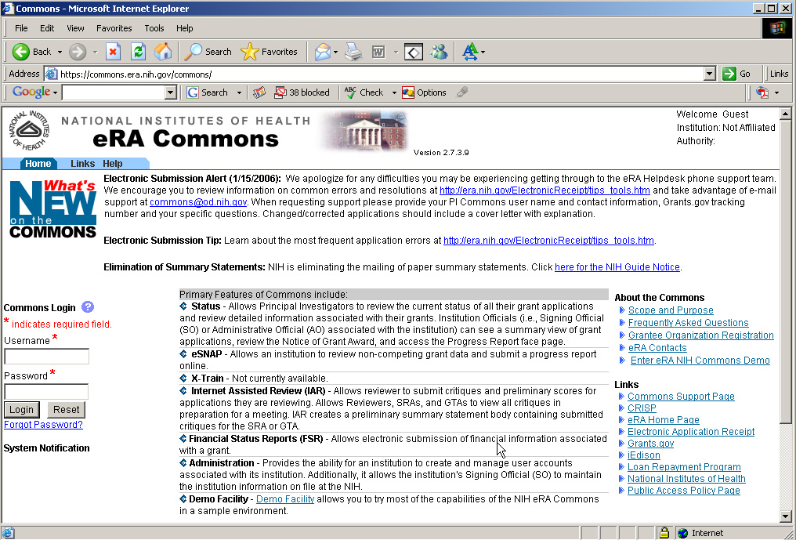
Following Process eRA Commons
<https://commons.era.nih.gov/commons/>

Slide 51
Proposal Tips
Benchmarks of an “outstanding” grant application
PI with strong track record/training
Hypothesis-driven
New, important, and original ideas
Strong preliminary data
Focused, incisive, and intelligently-designed research plan
Knowledge of published relevant work
Note: Study section members, like everyone else are vain
They feel their own work is very important!
Reasonable time-line
Experience in the essential methodology
Clear future directions and contingency plans

Slide 52
Rules to Follow
The application must be complete
Read carefully and follow instructions
Make it easy for the reviewers
Don’t work in a vacuum, collaborate
Be aware of changes in science and policies
Play it straight
Don’t give up, try again

Slide 53
UT Resources
Tips for grant writing
http://www.utoledo.edu/research/funding/propWriting.html
Links to major sponsors
http://www.utoledo.edu/research/funding/sponsors_and_programs.html
Guidelines and forms
http://www.utoledo.edu/research/funding/howtowrite.html

